Slide 1

PYCODERS
Team members:
Manasa M-3BR23EC091
Bhoomika-3BR23EC025
Bhumika C K-3BR23EC027
Waseema kousar-3BR23EC184

Slide 2
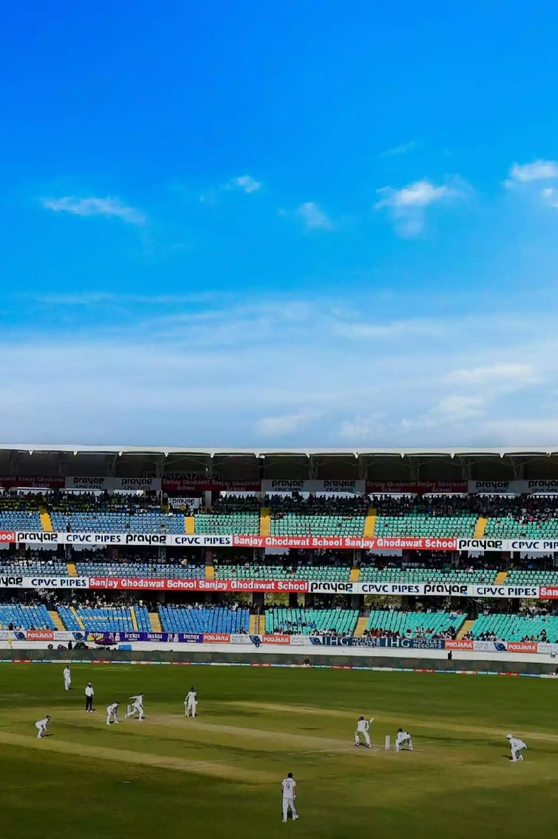
Sports league management system

Slide 3

INTRODUCTION:
Managing a sports league involves handling numerous tasks such as team registrations, scheduling matches, tracking player statistics, and ensuring smooth communication among participants. A robust and efficient sports league management system can significantly ease these operations. This document introduces a Python-based sports league management system designed to streamline the administration of sports leagues, providing a comprehensive solution for organizers, teams, and players.

Slide 4
Problem statement:
League Management System that allows users to manage a list of teams in a sports league. Sports The system should enable users to perform basic operations such as adding, viewing, updating, and deleting teams.

Slide 5

Domain:
A system designed to manage schedules , teams , scores , and logistics for organized sports leagues efficiently.

Slide 6

Objective:
The objective of a sports league management system is to efficiently manage teams, players, and match schedules. It streamlines tasks like adding, updating, and deleting information, recording scores, and generating performance reports, enhancing transparency and decision-making for league administrators, coaches, and players.

Slide 7
Algorithm:
1. Initialize league as an empty list.
2. Define add_team function : Create an empty dictionary team . Prompt user for team details and store in team . Append team to league . Print success message.
3. Define display_teams function : If league is empty, print message and return .Otherwise, print details of each team in league.
4. Define update_team function : Call display_teams . Prompt user for team number to update . If valid, prompt user for new details and update selected team . Print success message.
5. Define delete_team function : Call display_teams . Prompt user for team number to delete . If valid, remove selected team from league . Print success message.
6. Define menu function : Enter infinite loop : Print menu options . Prompt user for choice . Call corresponding function or exit based on choice.
7. If script is run directly, call menu function.

Slide 8
Module Split up:
Create():the program allows user to create new teams and record their mistakes
Update():the program automatically update the teams records when matches are added
Delete():the program includes the ability to delete teams from the tracker.
Display():he program displays the current records of all items.

Slide 9
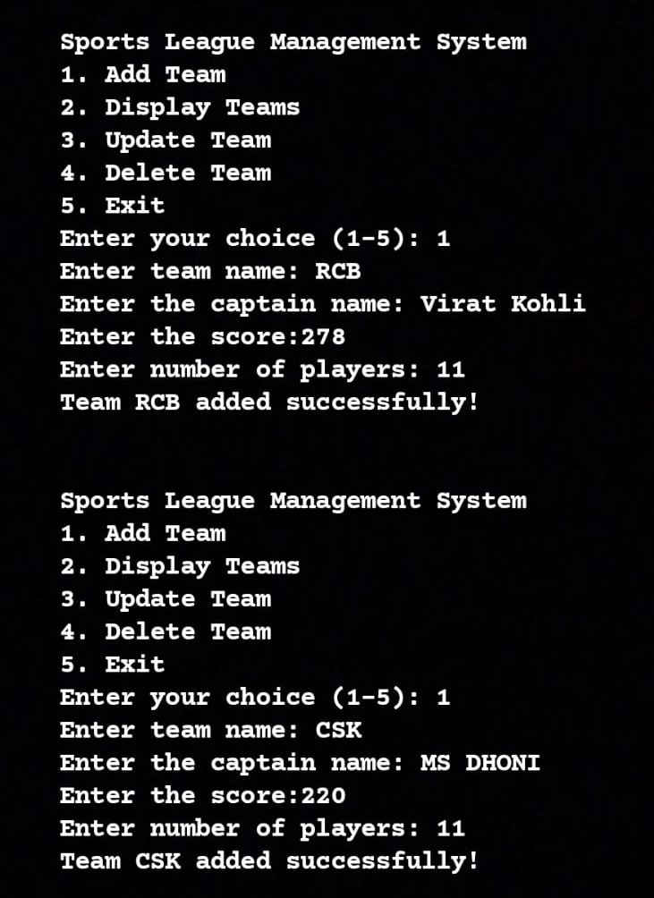
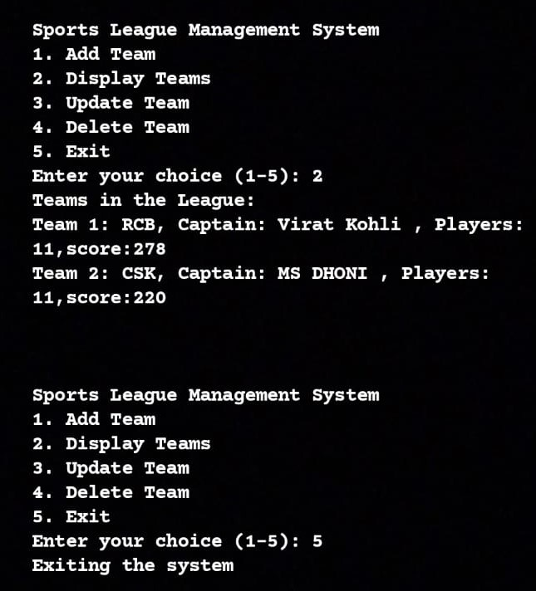
Result:

Slide 10
Conclusion:
The Python-based sports league management system enhances league administration by automating scheduling, statistics tracking, and communication. Utilizing frameworks like Django or Flask and databases such as SQLite or PostgreSQL, it offers scalability and reliability. This user-friendly system improves efficiency and transparency, allowing organizers to focus on fostering competitive sports environments, ultimately revolutionizing sports management with technology.

Slide 11
Future Enhancement:
Enhance the sports league management system by adding mobile app integration, advanced analytics, secure payment processing, live streaming, customization options, and social media integration. These features will increase accessibility, functionality, and user engagement, making the system more versatile and user-friendly.

Slide 12
